Slide 1

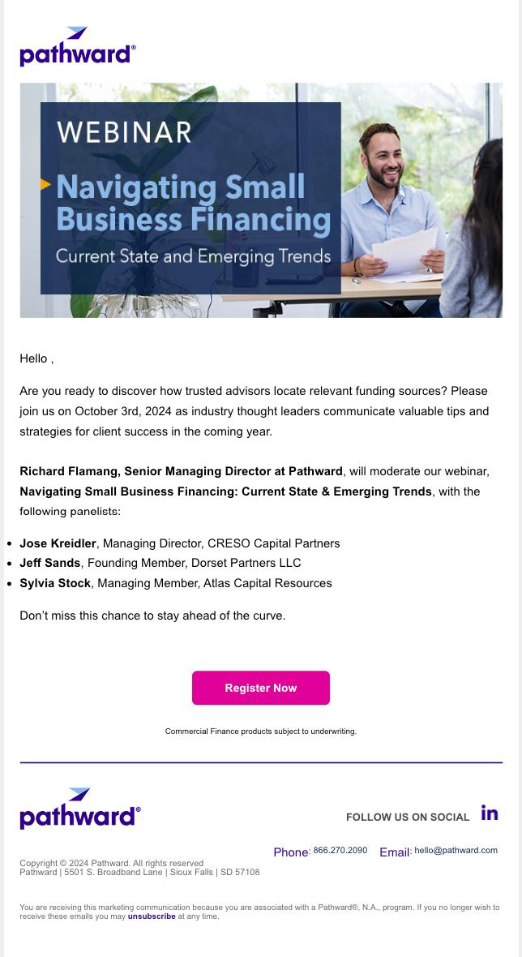


Commercial Finance Email Campaign
Completed our ABM campaign during the initial weeks of FY25
Target audience: institutional lenders, independent advisors
Email, display ads, and landing pages focused the on-going execution in the final stages by providing feature of capabilities through resource hub page with sell-sheets, articles, webinar, thought-leadership
We continue to email to this target audience to remain top of mind. Fresh content and funding announcements lead our messaging (see recent execution at right).
3K
Accounts Emailed
26K+ Sent | 3.7K+ Opens
(22.83%)
810K
Digital Ad Impressions
2.8K+ Clicks
CORE EXECUTION TEAM: Barbara Raus, Dan Webster, Tara Whittaker, Susan Witkowski, and Courtney Heidelberg

Slide 2
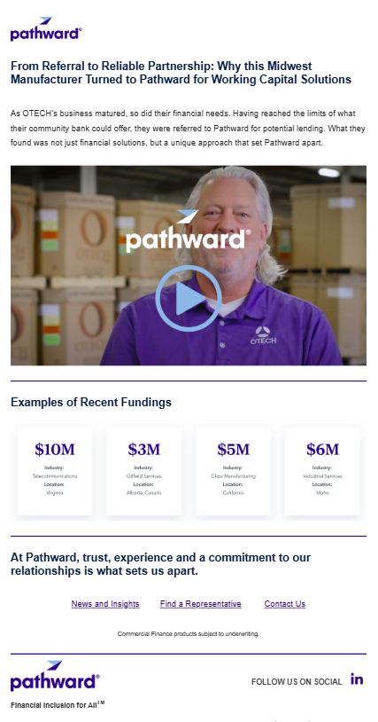
Commercial Finance Email Campaign
3166
Emails Delivered
3723 Sent | 12 Unsubscribes
SHIFT TO ON-GOING CAMPAIGN
Target audience: institutional lenders, independent advisors
Continue to email to this target audience to remain top of mind. Fresh content and funding announcements lead our messaging (see recent execution at right).
905.5
Opens (28.6%)
Ind Benchmark: 20-25%
18.9%
Click-to-Open Rate
% of Opens that result in clicks
CORE EXECUTION TEAM: Barbara Raus, Dan Webster, Tara Whittaker, Susan Witkowski, and Courtney Heidelberg

Slide 3


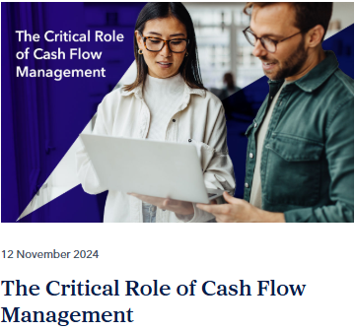
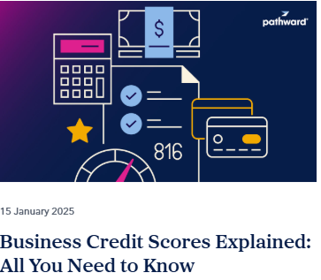
Commercial Finance Article Series
Following an execution of articles specific to SBA and USDA funding in FY 2024 Q2/3 we created and published a 3-part series on cash flow and follow up article about business credit.
These were supported with organic LinkedIn posts with each publish and shared across the ccl organization with tips for use in team members own outreach.
252 to 354
Range of Page Views
CORE EXECUTION TEAM: Barbara Raus, Dan Webster, Tara Whittaker, Susan Witkowski, and Courtney Heidelberg

